Slide 1
Implementation of Association Rule Mining

Slide 2
Submitted by :-
Chandra Shekhar Yadav(ADTU/2018-22/BCS/010)
Nilratan Sarkar(ADTU/L/2018-22/BCS/017)
Semester :- 7th sem , Department :- B.Tech(Computer Science)
Guided by : - Ms. Eirene Barua

Slide 3
TABLE CONTENTS
INTRODUCTION................................................................................................................... 4
WHY ASSOCIATION RULES ARE USED?................................................................................ 5
HOW ASSOCIATION RULE WORK......................................................................................... 6-7
ALGORITHMS USED(APRIORI ALGORITHM)......................................................................... 8
IMAGE EXMPLE OF APRIORI ALGORITHM............................................................................ 9
REAL WORLD USE CASES FOR ASSOCIATION RULES............................................................. 10-11
TECHNOLOGIES USED(PYTHON)........................................................................................... 12
SOFTWARE REQUIREMENTS................................................................................................. 13
ANACONDA........................................................................................................................... 14
JUPYTER NOTEBOOK............................................................................................................. 15
HARDWARE REQUIREMENTS................................................................................................ 16
SCREENSHOTS....................................................................................................................... 17-22
CONCLUSION......................................................................................................................... 23

Slide 4
INTRODUCTION
We in this project will mine association rules using apriori algorithm in jupyter notebook which is installed with anaconda.
In this project we will add some data , find frequent itemsets then mine association rules from it and save the results in an csv file.

Slide 5
Why Associations Rules are used?
In data mining, association rules are useful for analyzing and predicting customer behavior.
They play an important part in customer analytics, market basket analysis, product clustering, catalog design and store layout.

Slide 6
How Association Rules Work
An association rule has two parts: an antecedent and a consequent . An antecedent is an item found within the data. A consequent is an item found in combination with the antecedent.
Association rules are created by searching the dataset for frequent patterns and using the criteria support and confidence to identify the most important relationships. Support is an indication of how frequently the items appear in the data. Confidence indicates the number of times the statements are found true.

Slide 7
Association rules are typically created from rules well-represented in data.If rules are built from analyzing all the possible itemsets, there could be so many rules that the rules hold little meaning.

Slide 8
Algorithm Used : -
Apriori Algorithm : -
It is used for mining frequent itemsets .
It is used to operate on a database containing a lot of transactions, for instance, items brought by customers in a store.

Slide 9
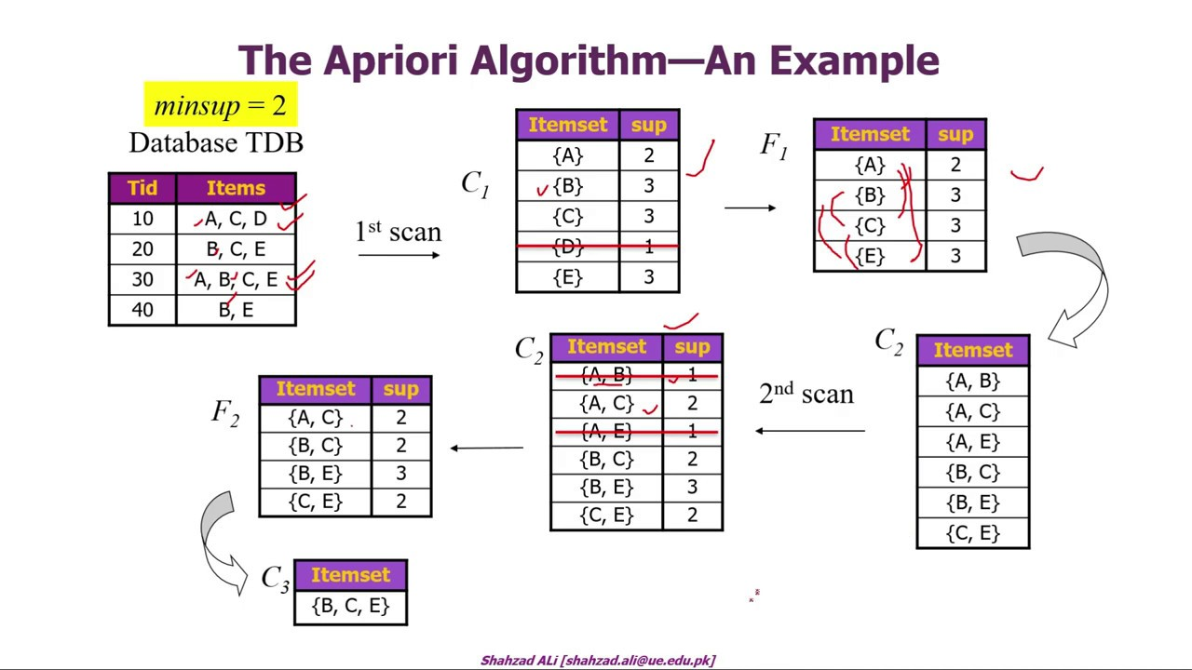

Slide 10
Below are a few real-world use cases for association rules : -
Medicine : - By using association rules and machine learning-fueled data analysis, doctors can determine the conditional probability of a given illness by comparing symptom relationships in the data from past cases.
Retail : - Machine learning models can look for co-occurrence in this data to determine which products are most likely to be purchased together. The retailer can then adjust marketing and sales strategy to take advantage of this information

Slide 11
User experience (UX) design : - Developers can collect data on how consumers use a website they create. They can then use associations in the data to optimize the website user interface -- by analyzing where users tend to click .
Entertainment : - Machine learning models analyze past user behavior data for frequent patterns, develop association rules and use those rules to recommend content that a user is likely to engage with, or organize content in a way that is likely to put the most interesting content for a given user first.

Slide 12

Technologies used : -
Python :- Python is often used to build websites and software, automate tasks, and conduct data analysis,data visualisation,AI and machine learning.

Slide 13
Software Requirements : -
Python
Anaconda Individual Edition

Slide 14

Anaconda : -
Anaconda aims to simplify package management and deployment.
The distribution includes data-science packages suitable for Windows, Linux, and macOS.

Slide 15

Jupyter Notebook : -
The Jupyter Notebook is an incredibly powerful tool for interactively developing and presenting data science projects.

Slide 16
Hardware Requirements : -
2 CPU cores
2GB Ram or Higher.
20 GB HDD or Higher.
Free space required 1.5GB .

Slide 17
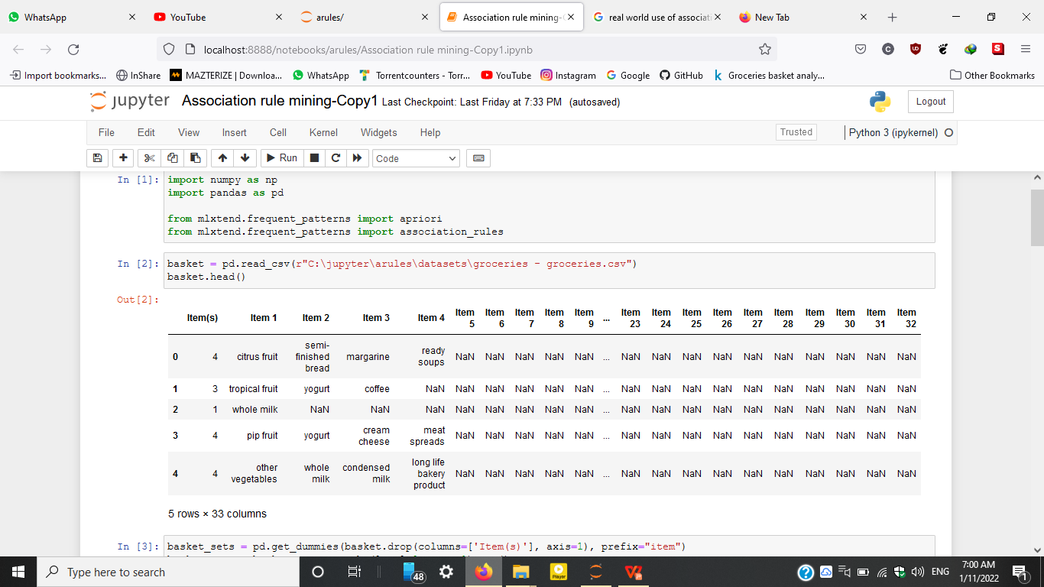
Screenshots : -

Slide 18
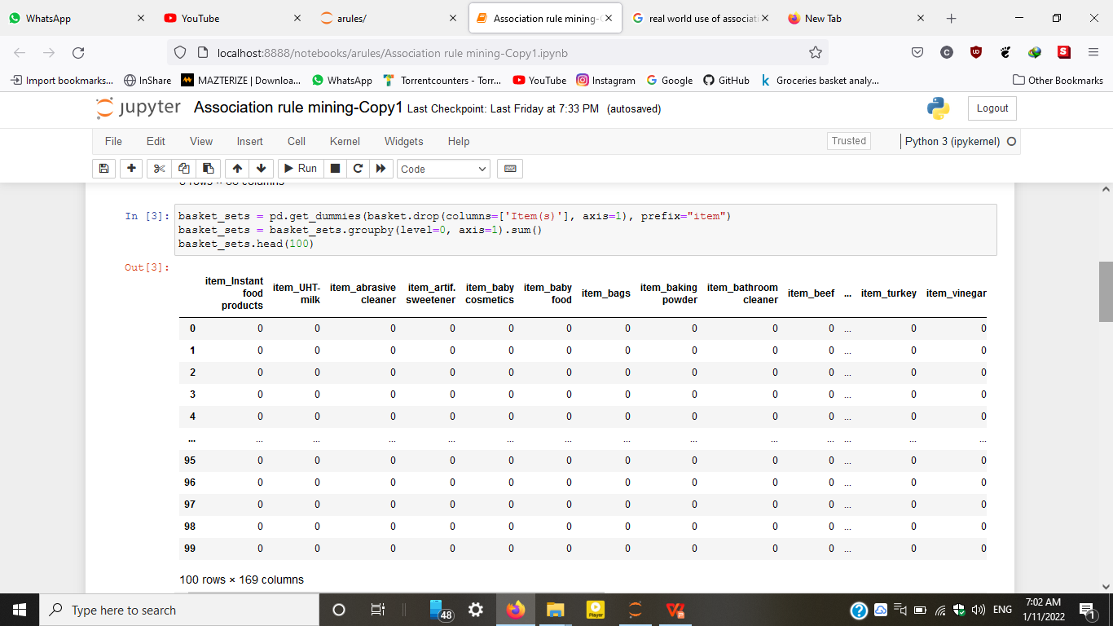

Slide 19
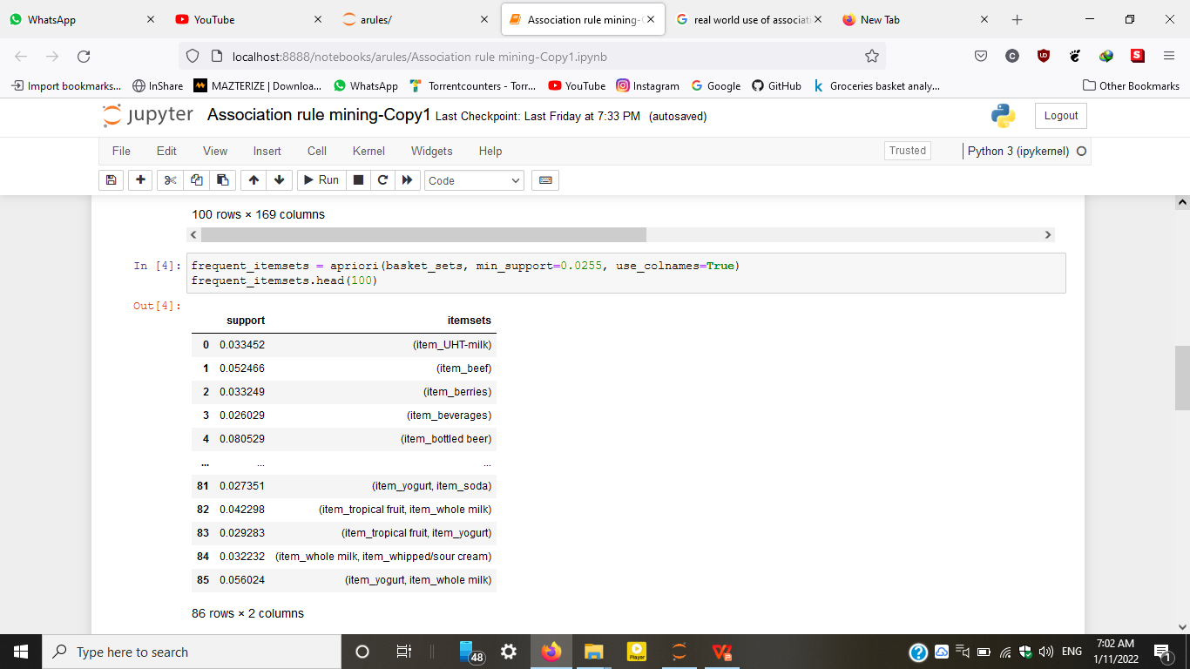

Slide 20
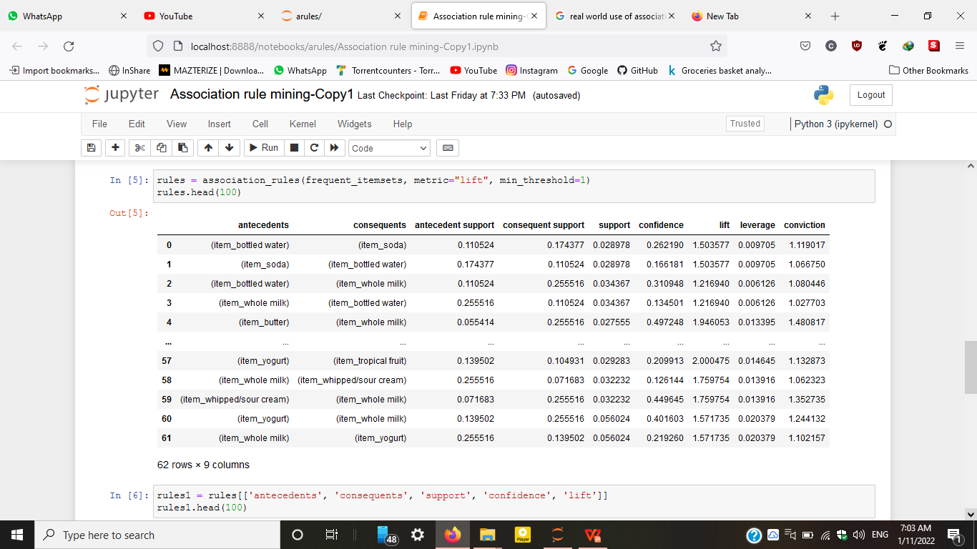

Slide 21
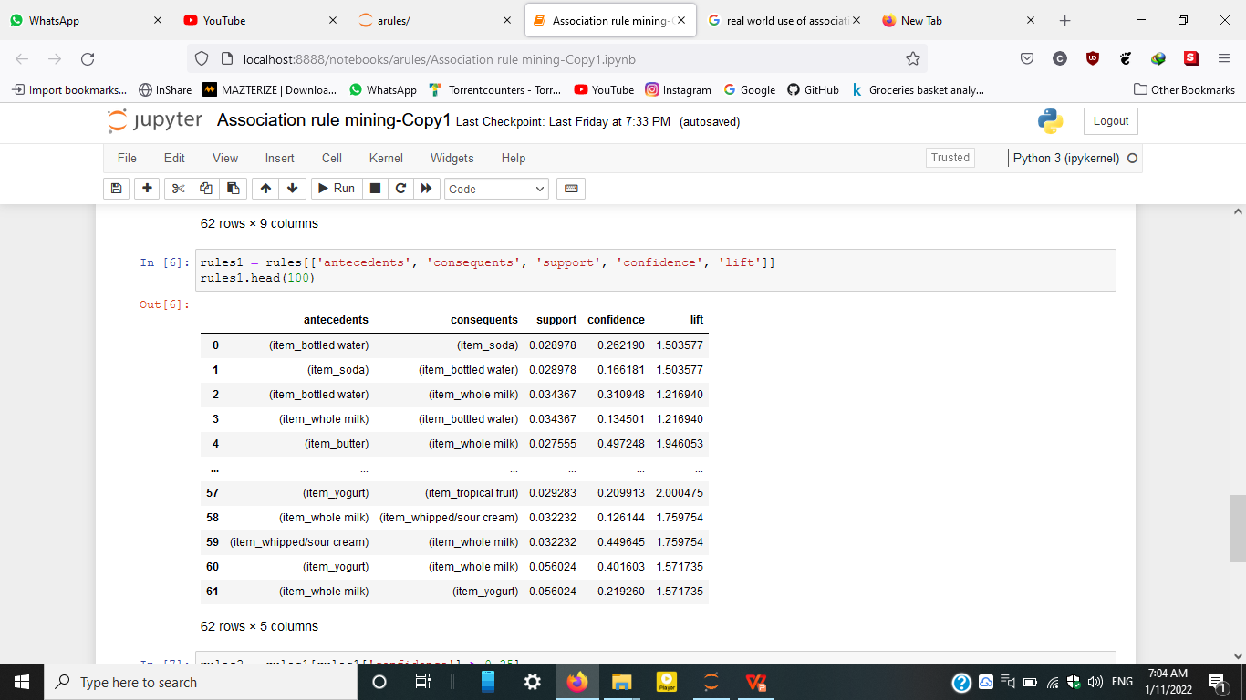

Slide 22
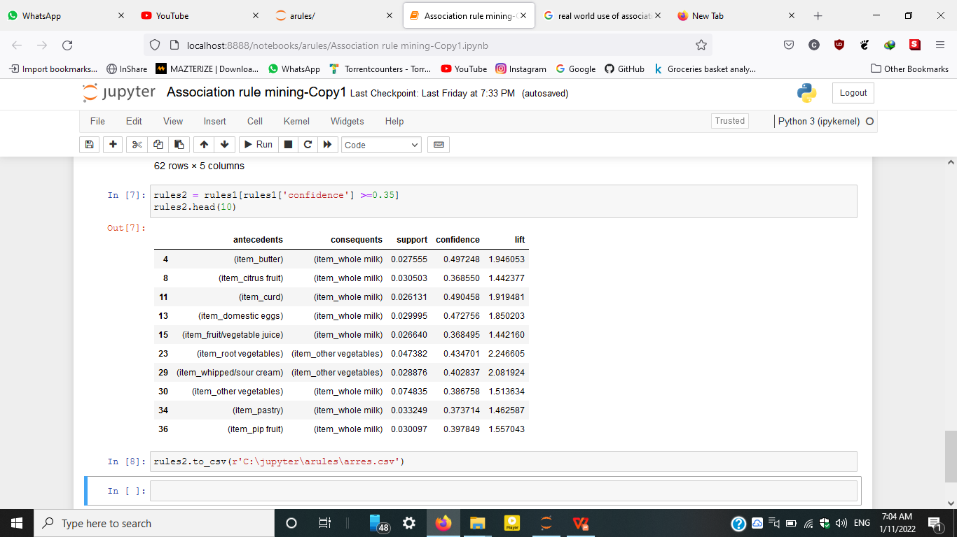

Slide 23
CONCLUSION
Association Rule Mining greatly helped us to develop our knowledge on Python.
Association rule mining can be greatly useful for businesses willing to increase their sales whether it's a small retail store or e-commerce website.

Slide 24
Thank You

